Slide 1
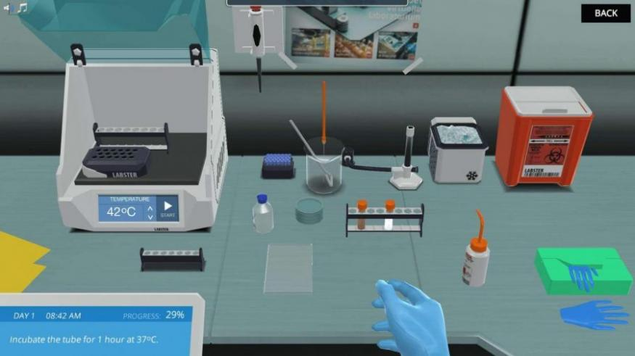

RUNTIME TERRORS – HACKATHON 2020
TOPIC: VIRTUAL LABORATORY
A PROJECT BY:
PRIYANSHI SHAH
PAKHI SRIVASTAVA
POOJA PATEL
ADITI AGARWAL
PALAK JAIN

Slide 2
PROBLEM STATEMENT-ED TECH
Exploring And Arriving On The Idea....
In the current times of COVID-19 we decided to build an app or website for education sector. Since the practical aspect of learning(by conducting experiments) was the one which was worst hit as majority don't have the things required to conduct experiments in their homes, we decided to tackle this issue, and thus explored the possibility of building a virtual lab where all the required things are available in online format and one can easily conduct experiments.
The Concept Of Virtual Lab
Virtual Lab will benefit school and college students who can't be physically present in the labs in the current pandemic situation to conduct the experiments. Also since it is online all the concepts and procedures can be taught and understood in an easy manner and all the contents can be accessed anytime anywhere.

Slide 3
What is the purpose of virtual lab?
The purpose of virtual lab is to complete the experiments online and explore concepts and theories without stepping into physical science lab.
How helpful is virtual lab?
Virtual labs enable students to perform experiments that are difficult to perform in real laboratories because of the risks due to pandemic.
Virtual labs help teachers save time and effort because they do not need to move from one place to another.

Slide 4
SOLUTION
To solve the problems stated above we have decided to create a virtual lab in the form of a website for the benefits of all students and learners.
The design of the website would be such that the tutor can get access to fit in a new experiment in the lab which can also be stored for later use.
The tutor would get to add in the apparatus required along with its picture.
Next, the tutor needs to add in the directions to connect the apparatus which the software stores.
When the student signs in with the unique code given to them by the tutor, the list of experiments the tutor has created is displayed and the student has to choose one of them.
As the student chooses an experiment , the student gets to join the connections of the apparatus and the website checks if the connections are correct as per the data entered by the tutor.

Slide 5
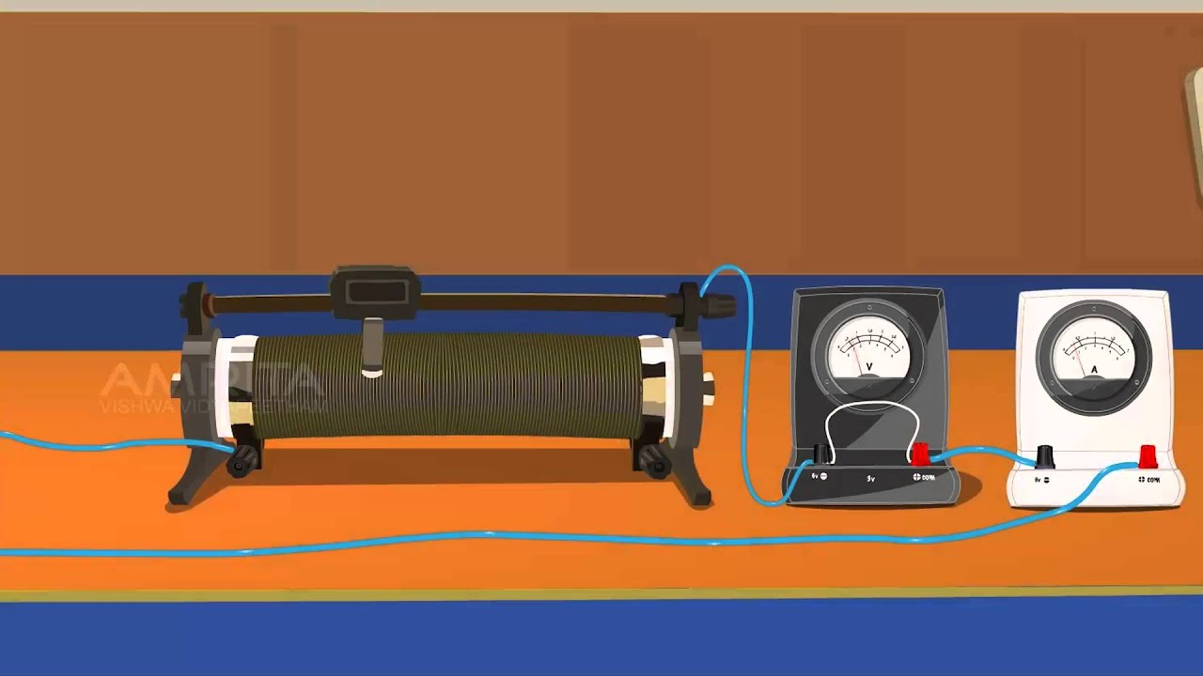
EXAMPLE
FOR EXAMPLE: EXP1 OHM’S LAW
The apparatus needed is: battery, voltmeter, ammeter, wires, resistor.
This information has to be entered by the tutor along with the way to connect them.
The students need to click on this experiment and they are provided with the pictures of the same. The student get to connect these with wires and their connections get automatically checked by the website once they click submit according to the data entered by the tutor

